Slide 1
The Maximum Bipartite Matching

Slide 2
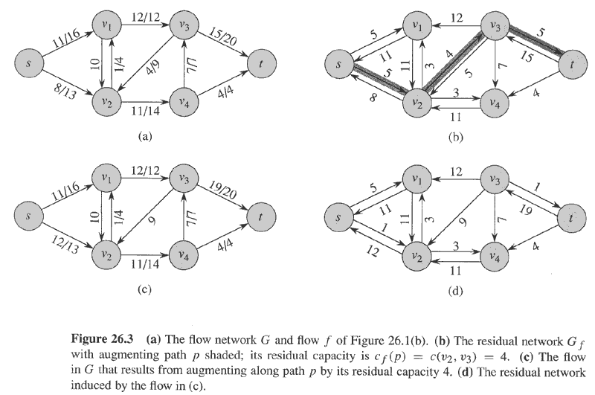
Example
Flow(1)
Residual(1)
No more augmenting paths → max flow attained.
Flow(2)
Residual(2)

Slide 3
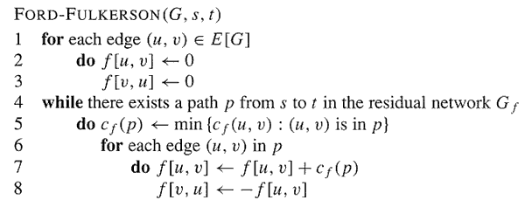
The Basic Ford-Fulkerson Algorithm

Slide 4
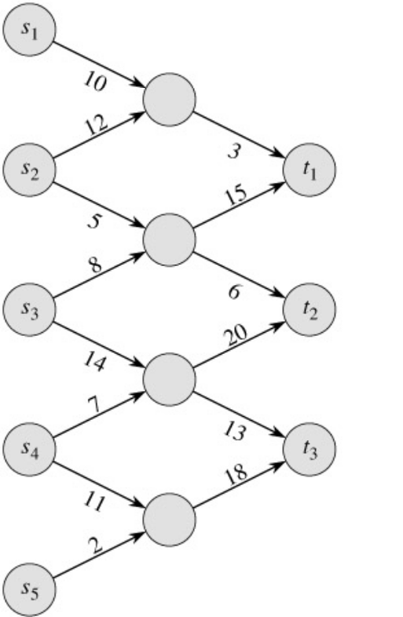
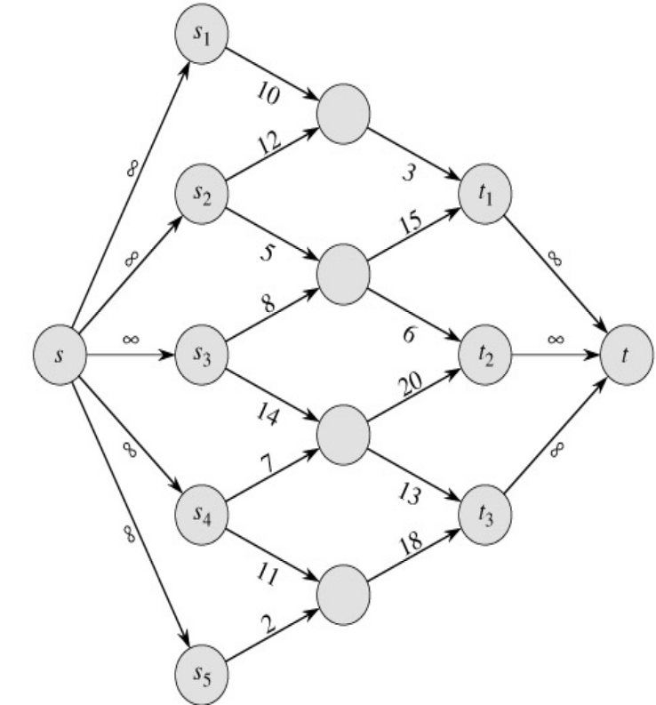
Multiple Sources Network
We have several sources and several targets.
Want to maximize the total flow from all sources to all targets.
Reduce to max-flow by creating a supersource and a supersink:

Slide 5
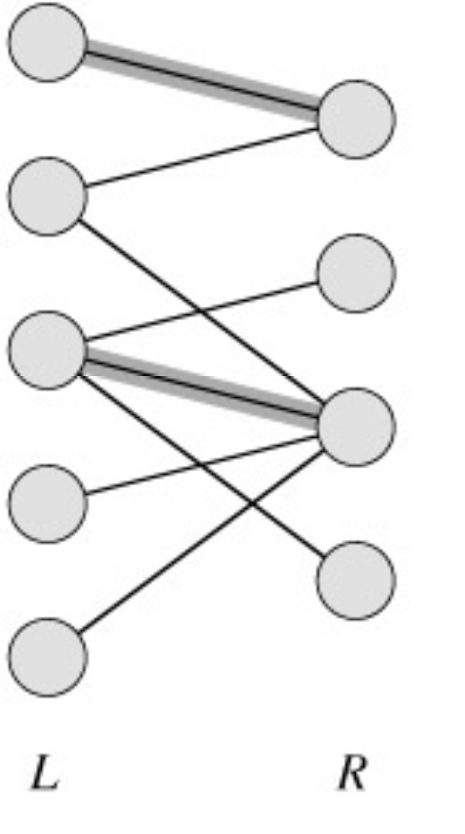
Maximum Bipartite Matching
A bipartite graph is a graph G=(V,E) in which V can be divided into two parts L and R such that every edge in E is between a vertex in L and a vertex in R.
e.g. vertices in L represent skilled workers and vertices in R represent jobs. An edge connects workers to jobs they can perform.

Slide 6
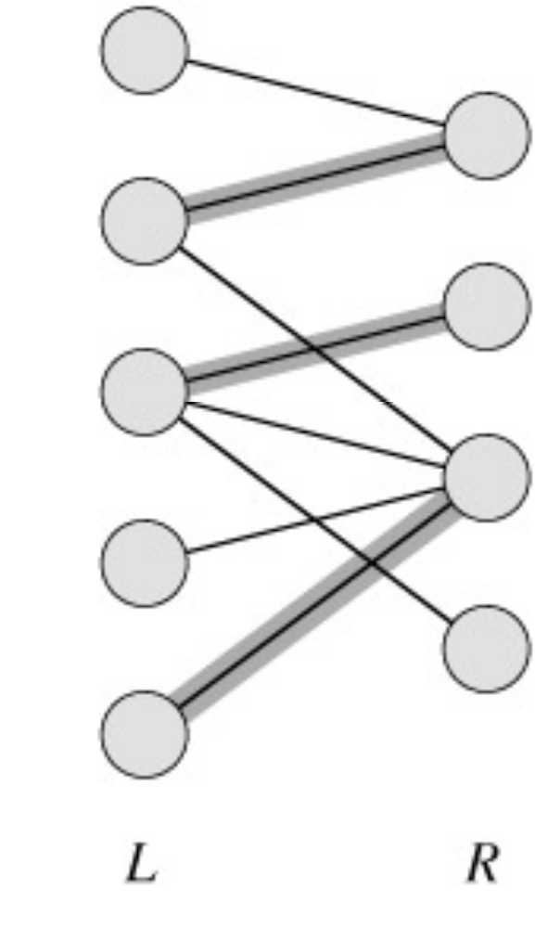
A matching in a graph is a subset M of E, such that for all vertices v in V, at most one edge of M is incident on v.

Slide 7
A maximum matching is a matching of maximum cardinality.
not maximum
maximum

Slide 8
A Maximum Matching
No matching of cardinality 4, because only one of v and u can be matched.
In the workers-jobs example a max-matching provides work for as many people as possible.
v
u

Slide 9
Solving the Maximum Bipartite Matching Problem
Reduce an instance of the maximum bipartite matching problem on graph G to an instance of the max-flow problem on a corresponding flow network G’.
Solve using Ford-Fulkerson method.

Slide 10
Corresponding Flow Network
To form the corresponding flow network G' of the bipartite graph G:
  Add a source vertex s and edges from s to L.
  Direct the edges in E from L to R.
  Add a target vertex t and edges from R to t.
  Assign a capacity of 1 to all edges.
Claim: max-flow in G’ corresponds to a max-bipartite-matching on G.

Slide 11
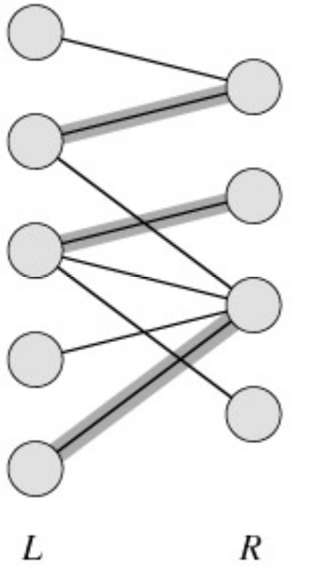
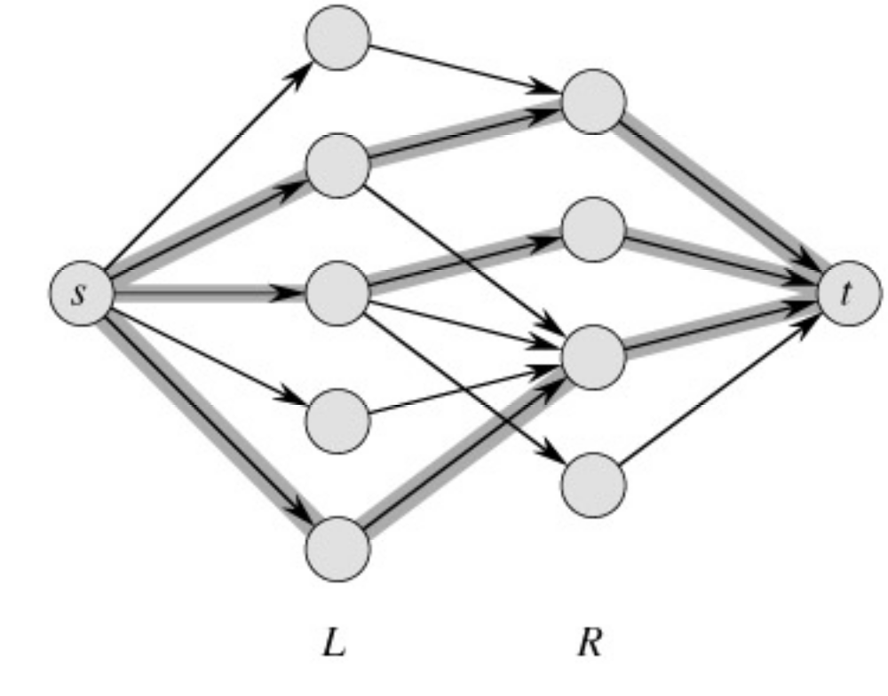
Example
min cut
|M| = 3 ←→ max flow = 3

Slide 12

Lemma (CLRS 26.10)

Slide 13
Why can’t we just say max |f| = max |M|?
Problem: we haven’t shown that f(u,v) is necessarily integer-valued for all (u,v) when f is a max flow.
It follows from the lemma that
max |M| = max [ integral flow],
but we also need
max [integral flow] = max |f|

Slide 14
Integrality Theorem (CLRS 26.11)
If the capacity function c takes on only integral values, then:
  The maximum flow f produced by the Ford-Fulkerson method has the property that |f| is integer-valued.
  For all vertices u and v the value f(u,v) of the flow is an integer.
So |M| = max [integral flow] = max |f|

Slide 15
Conclusion
Network flow algorithms allow us to find the maximum bipartite matching fairly easily.
Similar techniques are applicable in other combinatorial design problems.

Slide 16
Example
In a department there are n courses and m instructors.
Every instructor has a list of courses he or she can teach.
Every instructor can teach at most 3 courses during a year.
The goal: find an allocation of courses to the instructors subject to these constraints.

Slide 17
Two solutions using network flows
Solution 1: convert the problem into a bipartite matching problem.
Solution 2: convert the problem into a flow problem directly.

Slide 18
A more complicated problem
There are m student groups on campus.
We would like to form a committee with a president, 3 vice-pres, and 10 members at large.
The committee is formed by representatives of the groups.
Can add conditions:
  The first group can be represented by at most 2 members, any other group can be represented by at most one.
  The representative of the third group cannot be the president.
Reduce to network flows!

Slide 19

That’s All, Folks!

